Slide 1
Audit Compliance System
Team-2

Slide 2
VB6 Architecture
Forms
Buttons
Modules
Database
Store data
UI

Slide 3
Design
User Details
Admin/ Organization Login
Successful
Logout
Database
Unsuccessful
Store Readiness Assessment
Stock Audit
Successful
Auditor/User Login
Logout
Perform
Unsuccessful

Slide 4


Application Flow Diagram
Request
Shows the requested data
UI
Returns response
API GateWay
Returns response
REST API
Fetches data according to user’s request

Slide 5
Thank You!!

Slide 6
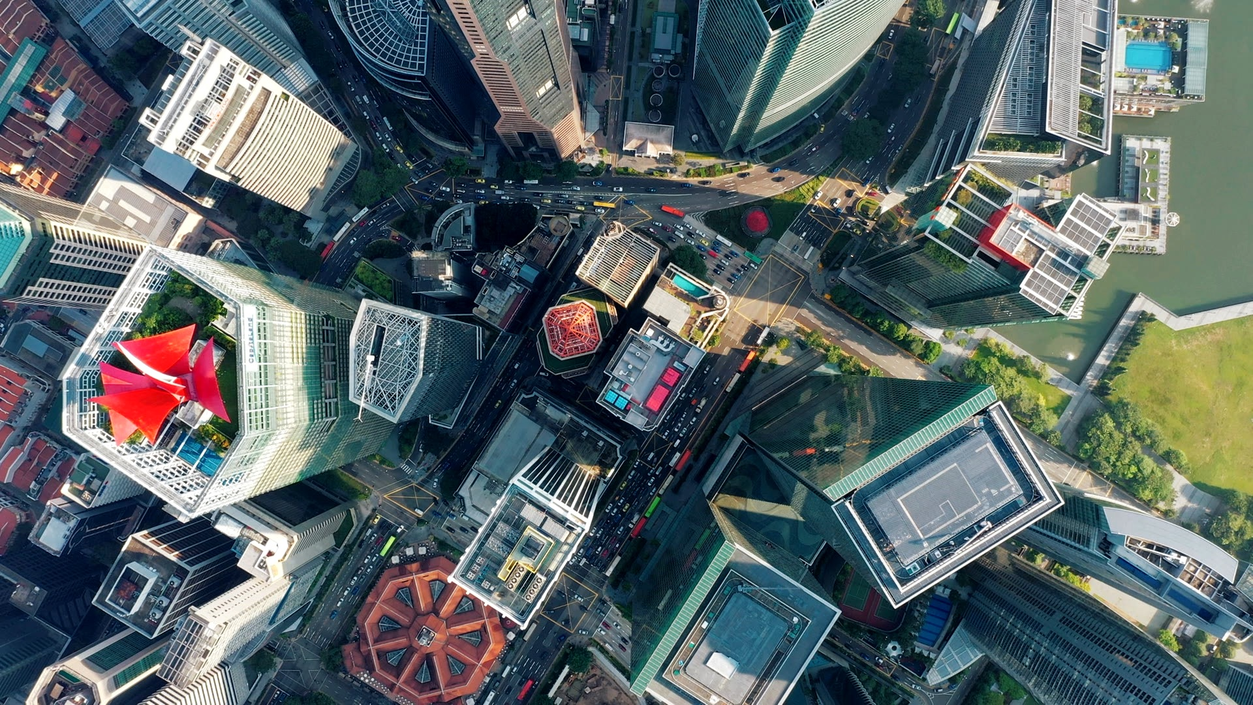

See Beyond, Rise Above.
Watch Brand Video
Notes:
Strong economic environment
Innovation at scale
Organizations focused on:
Adding customers
Expanding existing customers
On path to profitability and de-levering

